Slide 1
The Best Version of You
“Be yourself, everyone else is already taken” Oscar Wilde
“In these challenging times do not let your standards drop
Notes:
As we come up to the summer holidays during this unusual time, please take time to read this assembly and appreciate how fabulous you all are.

Slide 2
Notes:
Is it fair to say that the clip you have just seen showed some amazing skills and mastery?
These people were not born able to do any of those things – it took a huge amount of time to get to that level along with a few other important traits along the way.
What skills did these people need to be able to achieve all of those awesome things? –
Brilliant so let’s look at what some famous people said about becoming successful and how to become the best version of themselves

Slide 3
To achieve being the best version of you…
Imagination – you need to see it
Determination – you have to want it
Commitment – you have to keep going!
Notes:
Imagination – Christian Ronaldo said dreams are not what you see in your sleep, dreams are things that do not let you sleep.
Determination – Ariana Grande has said the quote that drove her on after the Manchester bombing were “the power of determination will make you unstoppable” and that’s what she did.
Commitment – David Beckham says that he had to train for over 10,000 hours to master his football skills, it was not natural talent that made him the best, he was committed to becoming the best.

Slide 4
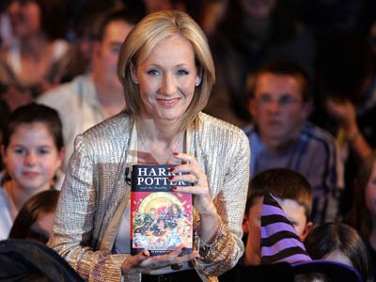
Her mum died, divorced, single parent living in relative poverty while writing the first Harry Potter novel.
Internationally renowned for her 7 book Harry Potter series and is the first person to become a billionaire from writing.
Notes:
She had an imagination that created some of the most famous characters in the world and she could see them and how they would come to life,
She was determined to put this onto paper even though it took her 7 years in between trying to work and look after her family, she couldn’t even afford a computer she typed the book on an old school typewriter
But that commitment went on to her becoming the first billionaire author etc.

Slide 5
Notes:
JK Rowling went through massive periods of doubt and almost talked herself out of finishing the book in the first place. She admits she is her own worst critic and even
When the book has been printed doubted her ability as a writer. How many times do we give ourselves a hard time about not being the best we can be and not listen to all the good things people tell you and say about you? If we do that over time, we start to only hear the negative words and not the positive that eats up our self esteem – which is how we feel about ourselves.

Slide 6
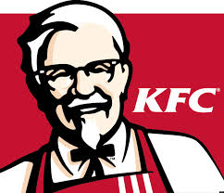
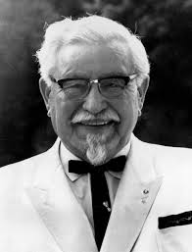
Harland David Sanders, could not sell his product to anyone. More than 1,000 restaurants rejected him.
Today there are KFC restaurants bearing his image all over the world.
Notes:
He imagined seeing his restaurants on every street in America
He was determined to open a restaurant of his own after over 1000 restaurants rejected his secret recipe
He was committed and worked 20 hour days putting tomatoes in tins to raise enough money to open that first restaurant.

Slide 7
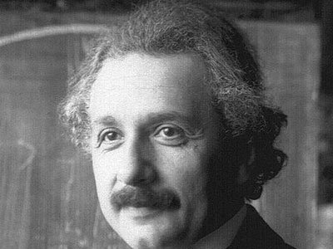
Didn't speak until age four and didn't read until age seven. His teachers labelled him "slow" and "mentally handicapped.“
Einstein just had a different way of thinking. He later won the Nobel prize in physics.
Notes:
It turned out he was dyslexic – he never questioned his own self and strived the be the best version of him even when others doubted him.

Slide 8
Notes:
Einstein wrote this phrase to demonstrate the everybody is does things in different way and just because one way works for one, it does not mean it will work for you and
This goes back to the first slide where Oscar Wilde quoted be yourself, because everyone else is taken.
Being the best version of you will be different to your friends best version of them. In these odd and uncertain times you must remember that you are an inspirational person who is
Responsible for showing the world who you can be.

Slide 9
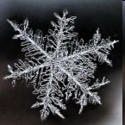
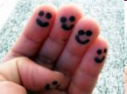
Just as no two snowflakes are alike, you are like no one else.
Notes:
Remember no 2 people in the world have the same DNA or fingerprints, including identical twins!

Slide 10
Notes:
So in order to be successful and your best you , you must firstly decide what that means for you? Does it mean moving up a set in maths, playing for the school football or netball team, getting into school everyday on time, being kind to everyone even if you are not friends, does it mean surviving lockdown without falling out with siblings?
You have already made the transition from primary school and starting building your foundation blocks for your secondary career – but how are you going to make sure you have memories of your best you?

Slide 11
What would you do today if you knew you wouldn’t fail?
Notes:
If you had £86,400 to spend everyday and if you didn’t spend it you lost it – what would you do with it?
That’s how many seconds you have in every day - so make them count towards becoming the best version of you.

Slide 12
“You can’t go back and change the beginning, but you can start where you are and change the ending” (CS Lewis)
Notes:
I hope you have enjoyed the assembly and take away some really important points. Thank you and Farewell from Mrs Power.

